Slide 1
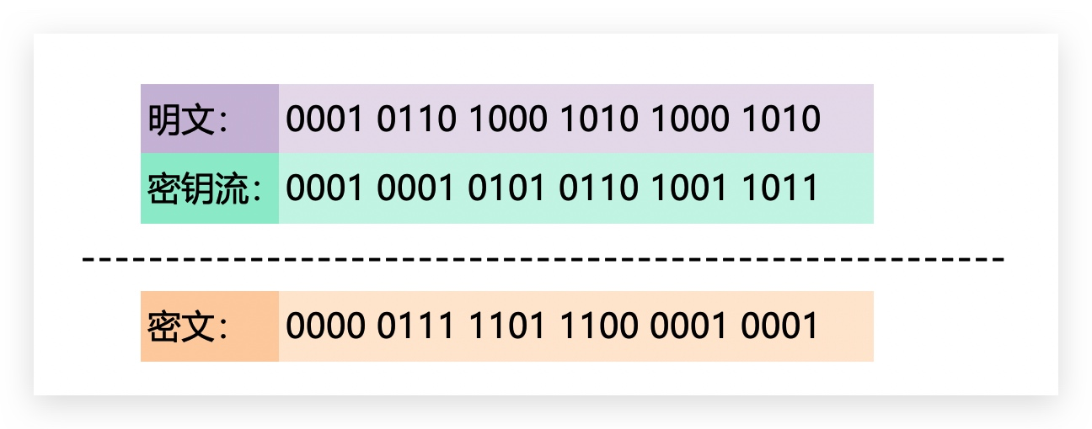
Chapter 2 – Stream Ciphers

Slide 2
Content of this Chapter
Intro to stream ciphers
Random number generators (RNGs)
One-Time Pad (OTP)
Towards Practical Stream Ciphers
Linear feedback shift registers (LFSRs)
A practical steam cipher: Salsa20
A practical stream cipher: Trivium

Slide 3
Content of this Chapter
Intro to stream ciphers
Random number generators (RNGs)
One-Time Pad (OTP)
Towards Practical Stream Ciphers
Linear feedback shift registers (LFSRs)
A practical steam cipher: Salsa20
A practical stream cipher: Trivium

Slide 4
Stream Ciphers in the Field of Cryptology
Cryptology
Cryptography
Cryptanalysis
Symmetric Ciphers
Asymmetric Ciphers
Protocols
Block Ciphers
Stream Ciphers
Stream Ciphers were invented in 1917 by Gilbert Vernam

Slide 5
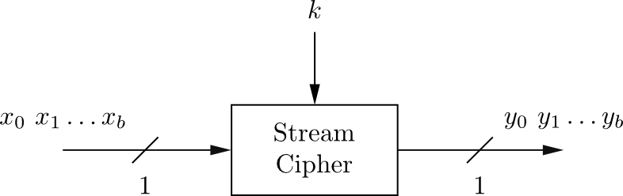
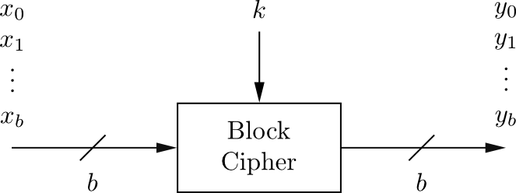
Stream Cipher vs. Block Cipher
Stream Ciphers
Encrypt bits individually
Usually small and fast → common in embedded devices (e.g., A5/1 for GSM phones)
Block Ciphers:
Always encrypt a full block (several bits)
Are common for Internet applications

Slide 6
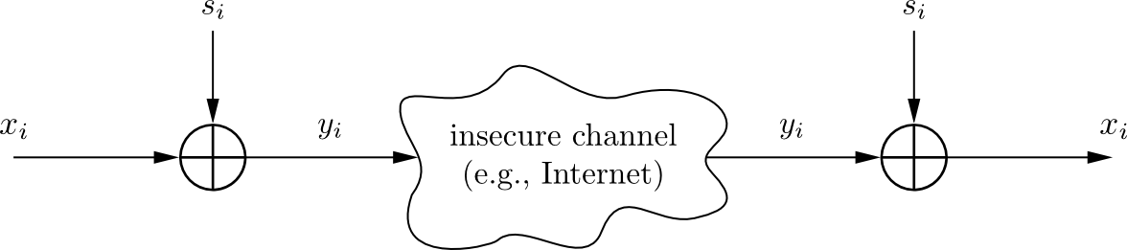

Encryption and Decryption with Stream Ciphers
Plaintext x_{i}, ciphertext y_{i} and key stream s_{i} consist of individual bits
Encryption and decryption are simple additions modulo 2 (aka XOR)
Encryption and decryption are the same functions
Encryption: y_{i} = e_{si}(x_{i} ) = x_{i} + s_{i} mod 2 x_{i} , y_{i} , s_{i} ∈ {0,1}
Decryption: x_{i} = e_{si}(y_{i} ) = y_{i} + s_{i} mod 2

Slide 7
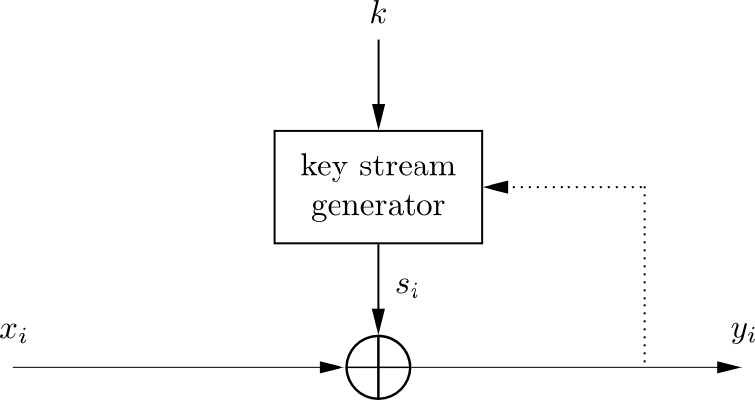
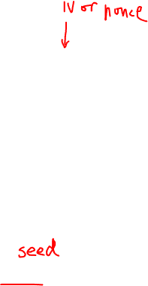
Synchronous vs. Asynchronous Stream Cipher
Security of stream cipher depends entirely on the key stream s_{i} :
Should be random , i.e., Pr(s_{i} = 0) = Pr(s_{i} = 1) = 0.5
Must be reproducible by sender and receiver
Synchronous Stream Cipher
Key stream depend only on the key (and possibly an initialization vector IV)
Asynchronous Stream Ciphers
Key stream depends also on the ciphertext (dotted feedback enabled)

Slide 8
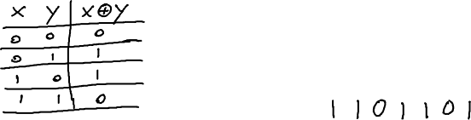
XOR (Exclusive-OR)
XOR of two strings in {0,1}^{n} is their bit-wise addition mod 2
0 1 1 0 1 1 1
1 0 1 1 0 1 0
⊕
Notes:
XOR is addition mod 2. Write truth table.

Slide 9


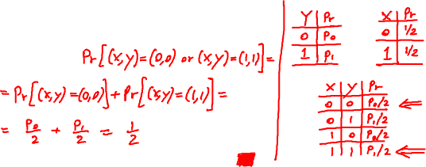
An important property of XOR
Thm: Y a rand. var. over {0,1}^{n} , X an indep. uniform var. on {0,1}^{n}
Then Z := Y⨁X is uniform var. on {0,1}^{n}
Proof: (for n=1)
Pr[ Z=0 ] =
Notes:
Put it another way. Being XORed with a uniformly random key bit string, all the statistic properties of the plaintext have been “erased”. On the contrary, the monoalphabetic substitution cipher cannot hide a statistic property (the letter frequency) of the plaintext in the corresponding ciphertext.

Slide 10
Why is Modulo 2 Addition a Good Encryption Function?
Modulo 2 addition is equivalent to XOR operation
For perfectly random key stream s_{i} , each ciphertext output bit has a 50% chance to be 0 or 1
→ Good statistic property for ciphertext
Inverting XOR is simple, since it is the same XOR operation
x_{i} | s_{i} | y_{i}
0 | 0 | 0
0 | 1 | 1
1 | 0 | 1
1 | 1 | 0
Notes:
Put it another way. Being XORed with a uniformly random key bit string, all the statistic properties of the plaintext have been “erased”. On the contrary, the monoalphabetic substitution cipher cannot hide a statistic property (the letter frequency) of the plaintext in the corresponding ciphertext.

Slide 11
Content of this Chapter
Intro to stream ciphers
Random number generators (RNGs)
One-Time Pad (OTP)
Towards Practical Stream Ciphers
Linear feedback shift registers (LFSRs)
A practical steam cipher: Salsa20
A practical stream cipher: Trivium

Slide 12
Random number generators (RNGs)
RNG
True RNG
Cryptographically Secure RNG
Pseudorandom NG

Slide 13
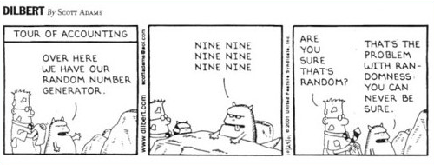
True Random Number Generators (TRNGs)
Based on physical random processes: coin flipping, dice rolling, semiconductor noise, radioactive decay, mouse movement, clock jitter of digital circuits
Output stream s_{i} should have good statistical properties: Pr(s_{i} = 0) = Pr(s_{i} = 1) = 50% (often achieved by post-processing)
Output can neither be predicted nor be reproduced
Typically used for generation of keys, nonces (used only-once values) and for many other purposes
Notes:
(1)Flipping a coin 100 times.
(2)Hardware-based TRNGs or TPM.
(3)Computer systems without a hardware TRNG.

Slide 14
Pseudorandom Number Generator (PRNG)
Generate sequences from initial seed value recursively
Typically, output stream has good statistical properties
Output can be reproduced and can be predicted
Often computed in a recursive way:
Simple PRNG: Linear Congruential Generator
Example: rand() function in ANSI C:
Most PRNGs have bad cryptographic properties!

Slide 15
Cryptographically Secure Pseudorandom Number Generator (CSPRNG)
Special PRNG with additional property:
Output must be unpredictable
More precisely: Given n consecutive bits of output s_{i} , the following output bits s_{n+1} cannot be predicted (in polynomial time) with better than 50% chance of success.
Needed in cryptography, in particular for stream ciphers
Remark: There are almost no other applications that need unpredictability, whereas many, many (technical) systems need PRNGs.

Slide 16
Content of this Chapter
Intro to stream ciphers
Random number generators (RNGs)
One-Time Pad (OTP)
Towards Practical Stream Ciphers
Linear feedback shift registers (LFSRs)
A practical steam cipher: Salsa20
A practical stream cipher: Trivium

Slide 17
One-Time Pad (OTP)
Unconditional Security:
A cryptosystem is unconditionally secure or information-theoretically secure or perfectly secure if it cannot be broken even with infinite computational resources.
One-Time Pad
The key stream s₀, s₁, s₂, … is generated by a true random number generator
Let the plaintext, ciphertext and key consist of individual bits x_{i}, y_{i}, s_{i} ∈ {0,1}.
Encryption: e_{si}(x_{i}) = x_{i} ⊕ s_{i} Decryption: d_{si}(y_{i}) = y_{i} ⊕ s_{i}
OTP is unconditionally secure if and only if every key stream bit s_{i} is used once!
Notes:
Requirements for a cipher to be unconditionally secure are tremendous.
A cipher with a key length of 10000 bits is not unconditionally secure.

Slide 18
One-Time Pad (OTP)
OTP is unconditionally secure:
y₀ = x₀ ⊕ s₀
y₁ = x₁ ⊕ s₁
:
It can be shown that this systems can provably not be solved:
Every equation is a linear equation with two unknowns. Impossible to derive a unique solution.
All the equations are independent, since all s_{i} are generated truly random.
Disadvantage:
For almost all applications the OTP is impractical since the key must be as long as the message! (Imagine you have to encrypt a 1GByte email attachment.)
For all unconditionally secure encryption system, the key must be at least as long as the message!

Slide 19
Content of this Chapter
Intro to stream ciphers
Random number generators (RNGs)
One-Time Pad (OTP)
Towards Practical Stream Ciphers
Linear feedback shift registers (LFSRs)
A practical steam cipher: Salsa20
A practical stream cipher: Trivium

Slide 20
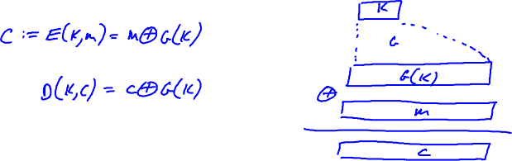
Towards Practical Stream Ciphers —— the idea

Slide 21
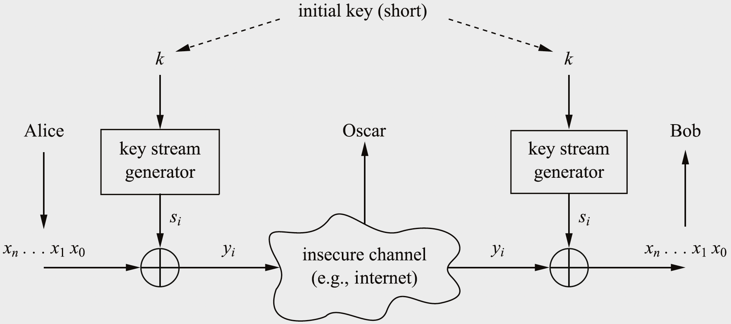
Towards Practical Stream Ciphers
But how to build the key stream generator?

Slide 22
Towards Practical Stream Ciphers
Computational Security:
A cryptosystem is computationally secure if the best known algorithm for breaking it requires at least t operations. (It is computationally infeasible for today’s computers to perform t operations.)
Several problems with this definition:
What is the best algorithm for a given attack?
Even if a lower bound on the complexity of one attack is known, are there more powerful attacks possible?
For symmetric encryption schemes, one hope that there is no attack method with a complexity better than an exhaustive key search.

Slide 23
Building Key Streams form PRNGs
Simple PRNG: Linear Congruential Generator
Assume
unknown A, B and S₀ as key
Size of A, B and S_{i} to be 100 bit
300 bit of output are known, i.e. S₁, S₂ and S₃
Solving
…directly reveals A and B. All S_{i} can be computed easily!
This a known-plaintext attack!
Bad cryptographic properties due to the linearity of most PRNGs

Slide 24
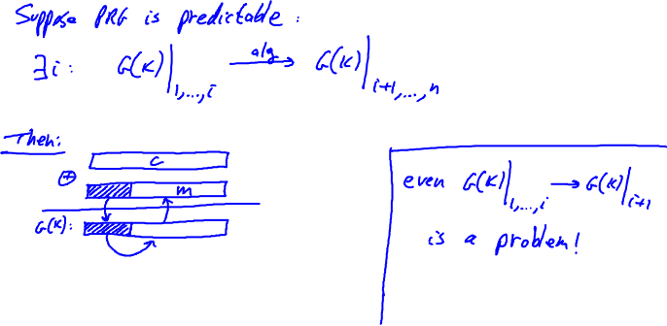
Building Key Stream from CSPRNGs
The key stream must be unpredictable.
Given n consecutive bits of output s_{i} , the following output bits s_{n+1} cannot be predicted (in polynomial time) with better than 50% chance of success.

Slide 25
Content of this Chapter
Intro to stream ciphers
Random number generators (RNGs)
One-Time Pad (OTP)
Towards Practical Stream Ciphers
Linear feedback shift registers (LFSRs)
A practical steam cipher: Salsa20
A practical stream cipher: Trivium

Slide 26
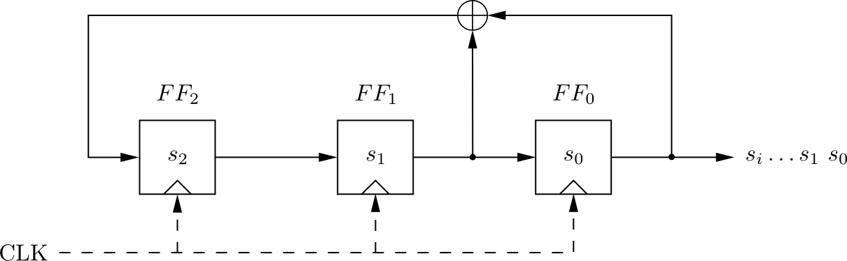
Linear Feedback Shift Registers (LFSRs): Example with m=3
clk | FF₂ | FF₁ | FF₀=s_{i}
0 | 1 | 0 | 0
1 | 0 | 1 | 0
2 | 1 | 0 | 1
3 | 1 | 1 | 0
4 | 1 | 1 | 1
5 | 0 | 1 | 1
6 | 0 | 0 | 1
7 | 1 | 0 | 0
8 | 0 | 1 | 0
LFSR output described by recursive equation:
Maximum output length (of 2³-1=7) achieved only for certain feedback configurations, .e.g., the one shown here.

Slide 27
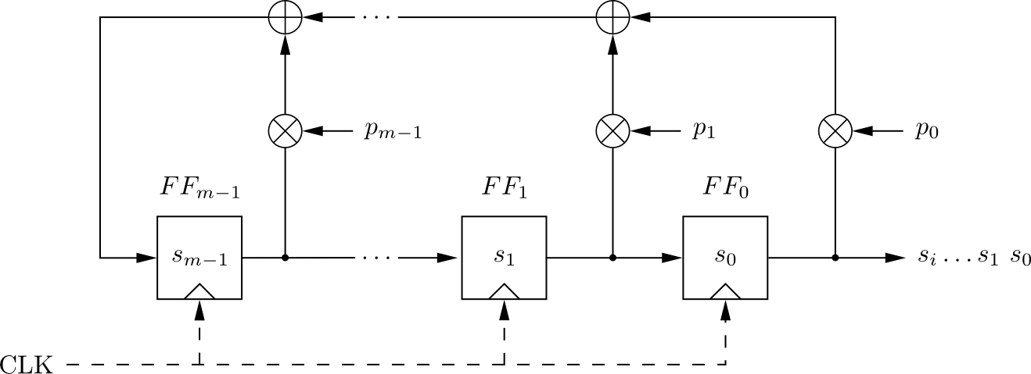
Linear Feedback Shift Registers (LFSRs)
Concatenated flip-flops (FF), i.e., a shift register together with a feedback path
Feedback computes fresh input by XOR-sum of certain state bits
Degree m given by number of storage elements
If p_{i} = 1, the feedback connection is present (“closed switch), otherwise there is not feedback from this flip-flop (“open switch”)
Output sequence repeats periodically
Maximum sequence length is 2^{m}-1
Notes:
Flip-flops 触发器，正反器（湾），二元存储器

Slide 28
Linear Feedback Shift Registers (LFSRs)
LFSRs typically described by polynomials:
A necessary and sufficient condition for the sequence generated by a LFSR to be maximal length is that its corresponding polynomial be primitive.
Primitive polynomials are a special type of irreducible polynomial.
Primitive polynomials can relatively easily be computed. Hence, maximum-length LFSRs can easily be found.
*See Chapter 2 of Understanding Cryptography for further details.

Slide 29
Security of LFSRs
LFSRs typically described by polynomials:
Single LFSRs generate highly predictable output
If 2m output bits of an LFSR of degree m are known, the feedback coefficients p_{i} of the LFSR can be found by solving a system of linear equations*
Thus vulnerable to known-plaintext attack
Because of this many stream ciphers use combinations of several LFSRs
*See Chapter 2 of Understanding Cryptography for further details.

Slide 30
Content of this Chapter
Intro to stream ciphers
Random number generators (RNGs)
One-Time Pad (OTP)
Linear feedback shift registers (LFSRs)
A practical steam cipher: Salsa20
A practical stream cipher: Trivium

Slide 31
Practical Stream Cipher – eSTREAM project
Stream ciphers had been popular in the 1980s
Block ciphers became more dominant during the 1990s due to the successful attacks against many of the early stream ciphers.
This was a main motivation for the eSTREAM project.
In 2004, eSTREAM issued a call for new stream ciphers and the selection process ended in 2008.
The ciphers were divided into two “profiles”
Profile 1 contains stream ciphers that allow high throughput software implementations. (Salsa20, Chacha20)
Profile 2 algorithms are hardware-friendly stream ciphers, which have a low gate count and power consumption. (Trivium)

Slide 32
Profile 1 – Salsa20
a family of software-efficient stream ciphers
based on 32-bit additions, rotations and XOR operations (referred to as add-rotate-XOR (ARX) ciphers)
The original cipher has 20 rounds and is denoted by Salsa20/20
faster than AES on most CPUs
Variants: Salsa20/12 and Salsa20/8
No known attacks better than a brute-force attack

Slide 33
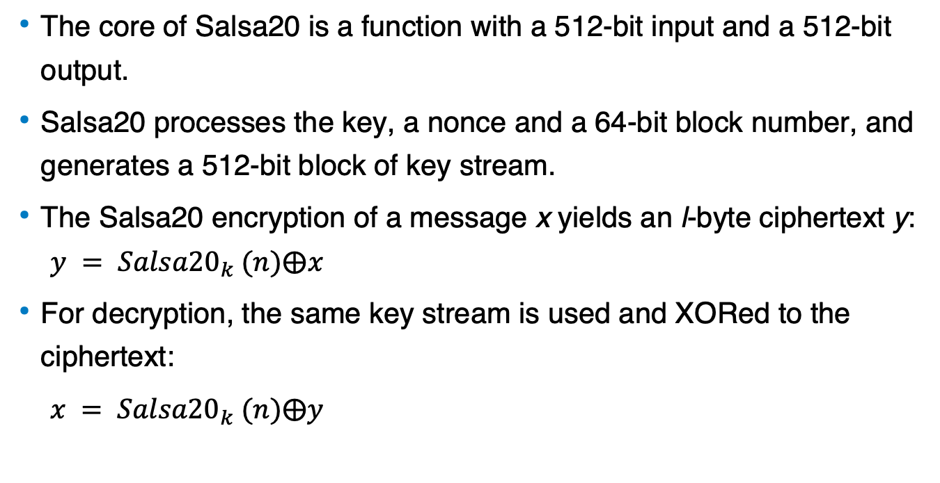
Encryption and Decryption with Salsa20
The core of Salsa20 is a function with a 512-bit input and a 512-bit output.
Salsa20 processes the key, a nonce and a 64-bit block number, and generates a 512-bit block of key stream.
The Salsa20 encryption of a message x yields an l-byte ciphertext y:
$$y = {Salsa20}_{k} (n)⨁x$$
For decryption, the same key stream is used and XORed to the ciphertext:
$x = {Salsa20}_{k} (n)⨁y$

Slide 34
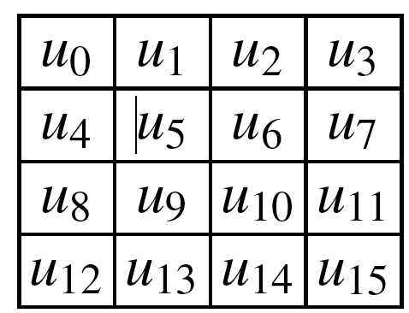
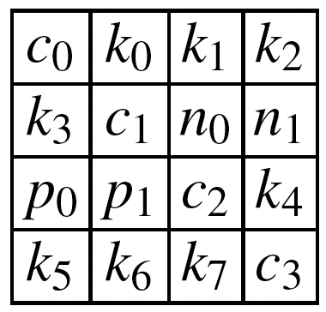
Internal State of Salsa20
The 512-bit internal state of Salsa20 consists of sixteen 32-bit words y_{i} and can be arranged as a 4-by-4 matrix:
To start the encryption process, the initial state of Salsa20 is constructed as follows. Eight 32-bit words are formed by the key k=[k₀k₁k₂k₃k₄k₅k₆k₇], two words indicate the stream position p = [p₀p₁], two words come from the nonce n = [n₀n₁] and four words are a constant c = [c₀c₁c₂c₃]

Slide 35
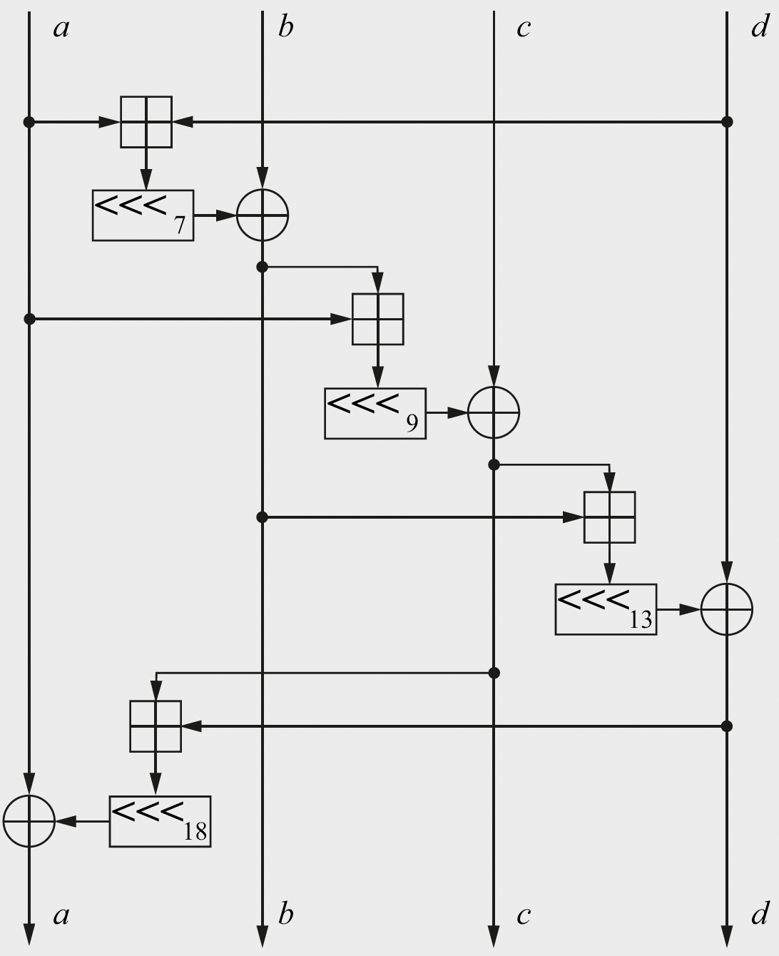
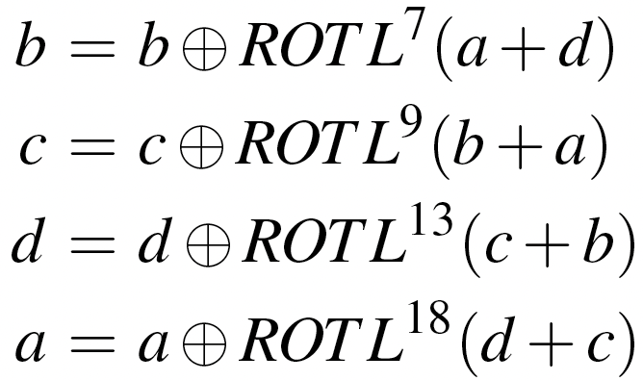
The quarter-round function
The core operation in Salsa20 is the quarter-round function QR(a,b,c,d):

Slide 36
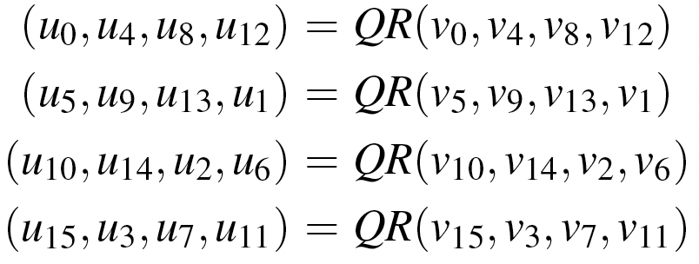
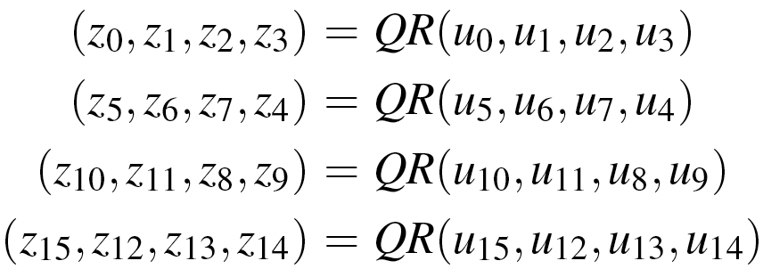
Four quarter rounds form a double-round
Four quarter rounds form a round, and two consecutive rounds are called a double-round: In odd-numbered rounds, QR is applied to each of the four columns in the 4-by-4 matrix. In even-numbered rounds, QR is applied to each of the four rows.
With an input (v₀,v₁, … , v₁₅), the output (u₀,u₁, … ,u₁₅) of the first (odd) round of the double-round is computed as follows.
The second round of the double-round yields the output (z₀,z₁, … , z₁₅):

Slide 37
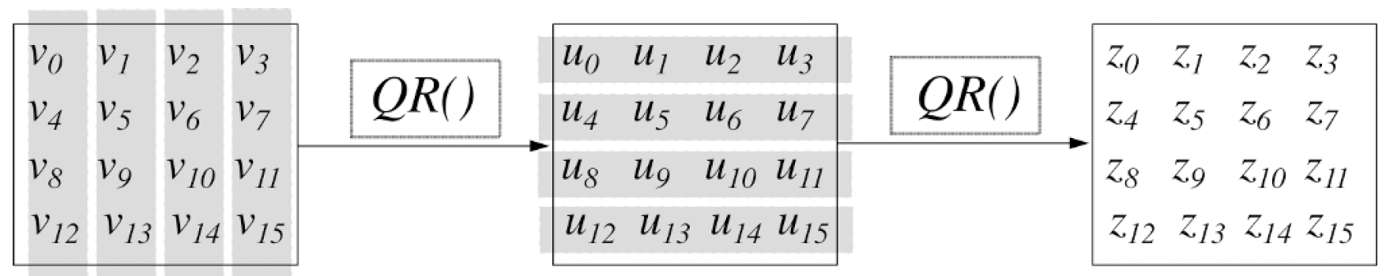
20 rounds or 10 double rounds are applied
For encryption or decryption, 20 rounds or 10 double rounds are applied.
In the last step, the mixed array is added, word by word, to the original array to obtain its 64-byte key stream block. This is important because the mixing rounds on their own are invertible.

Slide 38
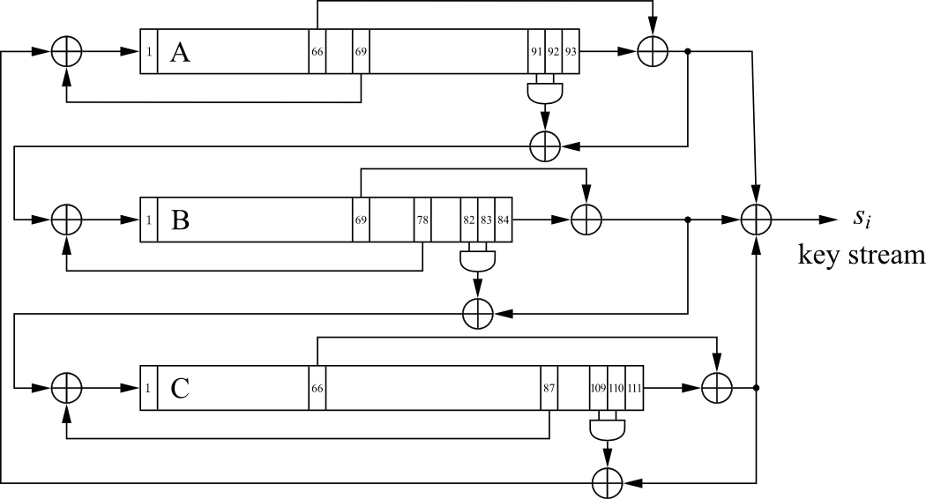
A Modern Stream Cipher - Trivium
Three nonlinear LFSRs (NLFSR) of length 93, 84, 111
XOR-Sum of all three NLFSR outputs generates key stream s_{i}
Small in Hardware:
Total register count: 288
Non-linearity: 3 AND-Gates
7 XOR-Gates (4 with three inputs)

Slide 39
Content of this Chapter
Intro to stream ciphers
Random number generators (RNGs)
One-Time Pad (OTP)
Linear feedback shift registers (LFSRs)
A practical steam cipher: Salsa20
A practical stream cipher: Trivium

Slide 40
Profile 2 — Trivium
Initialization:
Load 80-bit IV into A
Load 80-bit key into B
Set c₁₀₉ , c₁₁₀ , c₁₁₁ =1, all other bits 0
Warm-Up:
Clock cipher 4 x 288 = 1152 times without generating output
Encryption:
XOR-Sum of all three NLFSR outputs generates key stream s_{i}
Design can be parallelized to produce up to 64 bits of output per clock cycle
 | Register length | Feedback bit | Feedforward bit | AND inputs
A | 93 | 69 | 66 | 91, 92
B | 84 | 78 | 69 | 82, 83
C | 111 | 87 | 66 | 109, 110

Slide 41
Lessons Learned
Stream ciphers are less popular than block ciphers in most domains such as Internet security. There are exceptions, for instance, the popular stream cipher RC4.
Stream ciphers sometimes require fewer resources, e.g., code size or chip area, for implementation than block ciphers, and they are attractive for use in constrained environments such as cell phones.
The requirements for a cryptographically secure pseudorandom number generator are far more demanding than the requirements for pseudorandom number generators used in other applications such as testing or simulation
The One-Time Pad is a provable secure symmetric cipher. However, it is highly impractical for most applications because the key length has to equal the message length.
Single LFSRs make poor stream ciphers despite their good statistical properties. However, careful combinations of several LFSR can yield strong ciphers.

